Slide 1
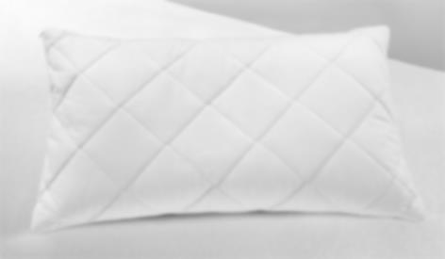
Product Information Index
Click headings to go to page
Page 2: Mattress & Pillow Protectors
Page 3: Terry towel waterproof mattress & pillow protectors
Page 4: White Bed Linen
Page 5: White Satin Stripe Bed Linen
Page 6: Vat Dye Coloured Bed Linen
Page 7: Blankets
Page 8: Quilts (Doonas)
Page 9: Pillow Collection
Page 10:Mattress Toppers
Page 11:White Bath Linen Collection
Page 12:Coloured Vat Dye Bath Linen Collection
Page 13:Bed Bug Mattress & Pillow Protectors
Page 14:Waterproof Quilted Mattress Protector
Cover and Protect Pty Ltd Sydney N.S.W.
Sales Ph.: 02 931 66654
Email: sales@coverandprotect.com.au
Freight Charges will be calculated on location of order. Delivery time approx. 2-3 Business day’s metro areas
Prices may change without notice.

Slide 2
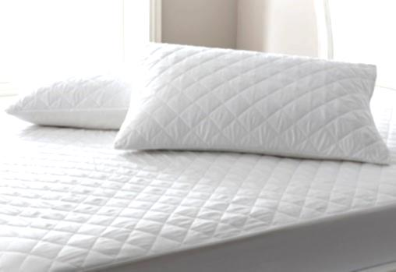
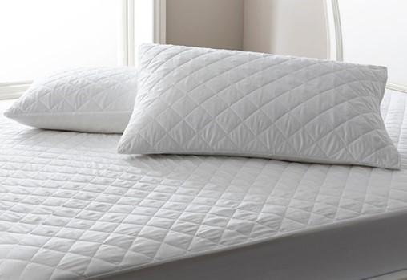
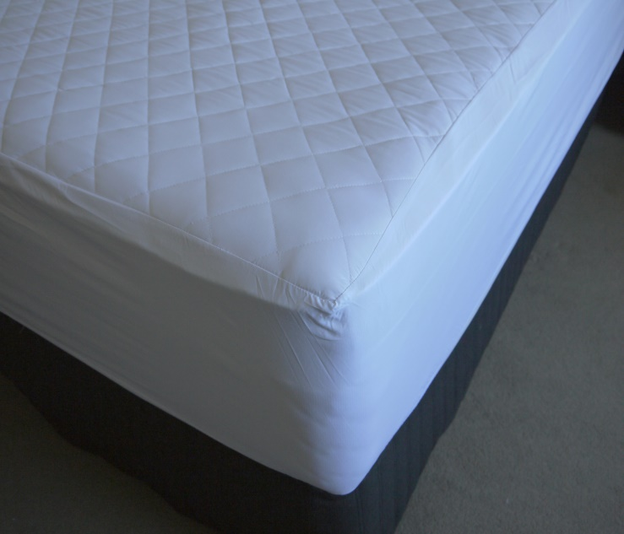
Mattress & Pillow Protectors
Mattress Protectors
100gsm polyester fill, durable microfibre fabric cover on both sides diamond stitch quilted. Available in two styles: re-enforced elastic corner straps or fitted skirt (wall depth approx. 36cm)
Available in:
Single 90x190cm
King single 104x203cm
Long single 92x203cm
Double 137x190cm
Queen 152x203cm
King 182x203cm
Pillow Protectors
100gsm polyester fill, durable microfibre fabric cover on both sides diamond stich quilted, zip closures.
Available in:
Standard 46x72cm
Euro 65x65cm
King 52x92cm
Non-woven Fabric Pillow Protectors
Zip closure or envelope closure, available in standard and king size

Slide 3
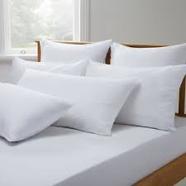
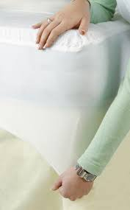
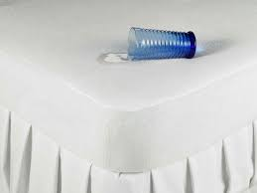
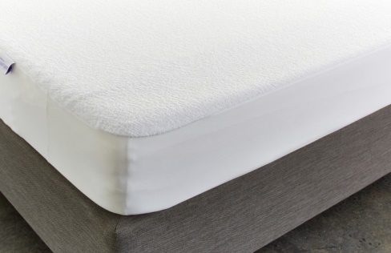
Terry towel waterproof mattress & pillow protectors
Our terry protectors are Australian Made. They have a very thin & absorbent terry towel top and breathable waterproof poly membrane backing, they are soft to touch, quiet to sleep on and will not make you hot or sweaty.
Repels liquids and protects your mattress from liquid spills, body fluids, stains
Waterproof pu membrane backing with fitted skirt 100% polyester knit
Absorbent sleep surface. 80% Cotton, 20% Polyester
Expands to fit depths 20-50cm will fit standard & pillow top mattresses
Helps with dust mite infestation and stops bacteria breeding
Tested for harmful substances to the Oeko-Tex Standard 100 standard
Safe to use with an electric blanket
Can be machine washed and tumble dry on cool heat
Super thin material does not take away from the comfort of the mattress and is not noisy to sleep on
Available in two ranges: Deluxe 60degree & Gold 95degree wash tested
Mattress protectors available in Single 92x188cm , King single 107x204cm, Ext long single 92x204cm, Double 138x188cm, Queen 152x204cm, King 183x204cm
Pillow protectors Zipper close
Standard 45x70cm
King 50x90cm
European 65x65cm

Slide 4
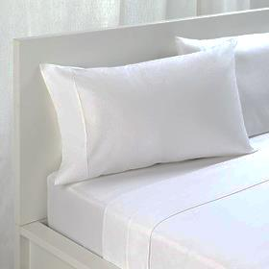
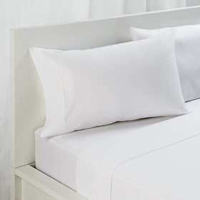
White Bed Linen
50% Combed cotton/ 50% Polyester, homongenous blend, mercerized, approx. 155gsm
Available in:
Single 180x300cm
Queen 249x300cm
King 284x300cm
Standard pillowcase 78x50x14cm
Queen size pillowcase 50x80x20cm
King size pillowcase 52x92x20cm
75% Combed cotton/ 25% Polyester – cotton rich, homongenous blend, mercerized, approx. 150gsm
Available in:
Single 180x300cm
Queen 249x300cm
King 284x300cm
Standard pillowcase 78x50x14cm
Budget Collection
50% Carded cotton/ 50% Polyester, homongenous blend, NOT mercerized, approx. 155gsm
Available in:
Single 180x300cm
Queen 249x300cm
King 284x300cm
Standard pillowcase 78x50x14cm

Slide 5
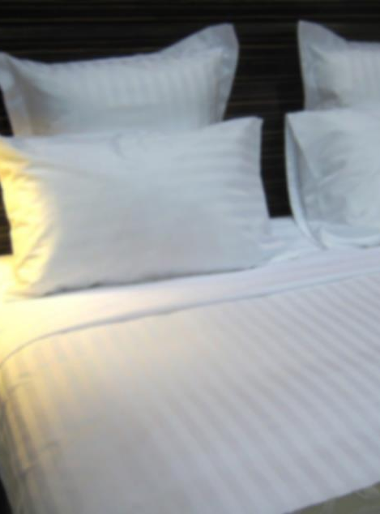
White Satin Stripe Bed Linen
10mm or 20mm Sateen satin vertical striped sheeting
50% Combed cotton/ 50% Polyester, homongenous blend, mercerized, approx. 160gsm
Available in:
Single 180x290cm
Queen 249x290cm
King 275x290cm
Standard pillowcase 78x50x14cm (Horizontal Stripe)
King size pillowcase 52x92x20cm (Horizontal Stripe)
10mm or 20mm Sateen satin vertical stripe quilt covers
50% Combed cotton/ 50% Polyester, homongenous blend, mercerized, approx. 160gsm, envelope closure
Available in:
Single 140x215cm
Queen 210x215cm
King 245x215cm

Slide 6
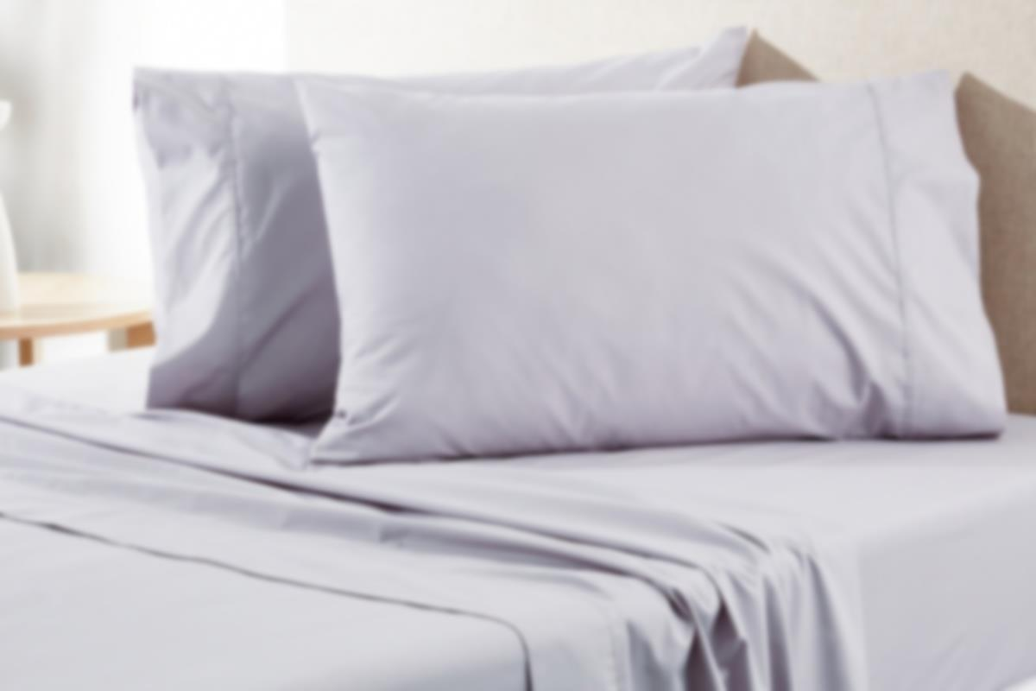
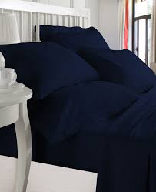
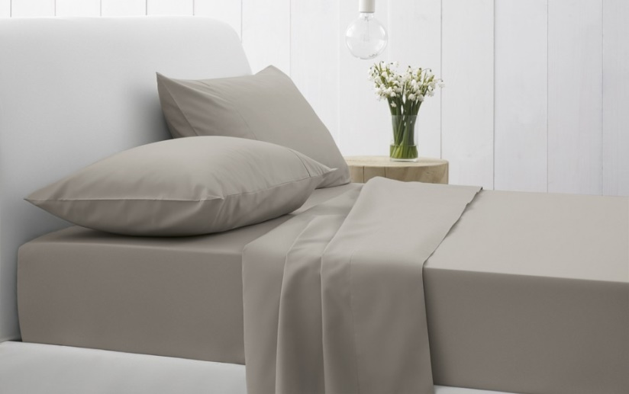
Vat Dye Coloured Bed Linen
50% Carded cotton/ 50% Polyester, vat dye colours, homongenous blend, mercerized, approx. 155gsm
Mushroom, Charcoal Grey & Navy
Available in:
Single 180x290cm
Single fitted 91x188x33cm
Pillowcase 78x50x14cm
Please note: Special orders in all colours can be manufactured to meet your size specifications

Slide 7
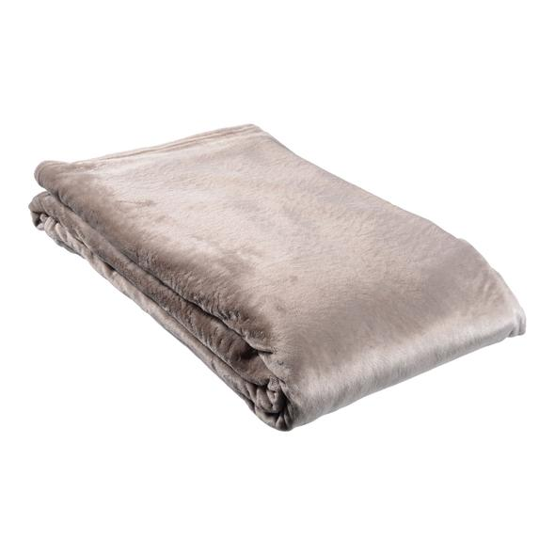
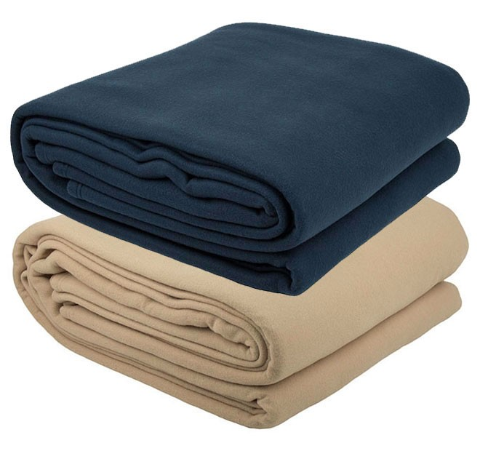
Plush Microfibre Blanket Mushroom
Polar Fleece Blanket
Polar Fleece Blanket
100% polyester, approx. weight 380gsm, anti-pill
Colours: Beige & charcoal grey
Available in:
Single/ king single 190x250cm
Queen 245x250cm
King 275x250cm
Plush Microfibre Blankets
Material 100% Polyester/Microfibre Plush blanket
Colours Mushroom & Charcoal Grey
Available in:
Single/ king single 190x250cm
Double/ Queen 245x250cm
King 275x250cm

Slide 8
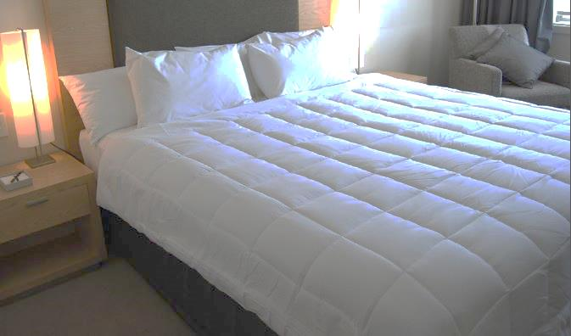
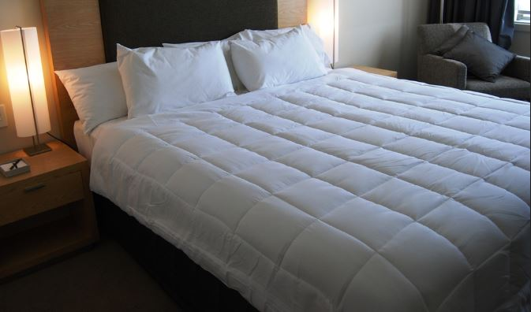
Quilts (Doonas)
350gsm Microfibre Fill Quilt
If you are looking for an all-round seasons quilt doona, then our impressive micro-loft fill quilt is the one for you!
We have designed this quilt doona with a luxurious 350gsm micro-loft fill, with a stunning, soft to the touch 220 thread count microfibre fabric cover, cassette box stitch with a neat binding edge to complete this quality product.
Specifications
Material 220 Thread Count Microfibre, cassette box stitch and binding edge
Fill 350gsm Micro-loft
Colour White
Available in:
Single 140x210cm
King Single 160 x 210cm
Queen 210x210cm
King single 160x210cm
King 240x210cm

Slide 9
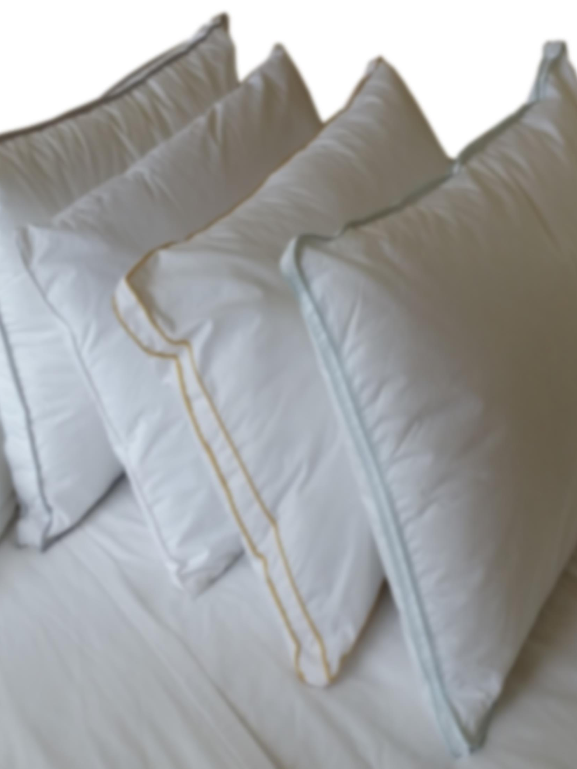
Pillow Collection
Indulgence Pillow
This pillow fill is made up of elasticized polyester, allowing for good bounce back, the pillow cover is a durable Japara cotton cover.
Available in:
Standard pillow size 45x70cm, fill weights of 500gsm, 600gsm, & 700gsm
Single piped edge 500gsm and/or 600gsm
Double piped edge yellow ID thread 700gsm
Euro pillow 850gsm 65x65cm
Luxury Collection
Micro-Loft fill, 233 thread count percale cotton cover, double piped edge
Manufactured with a micro-loft fill, soft feeling 233 thread count cotton cover, with a coloured ID thread piped edge/ Gusset side, perfect to identify the fill weight during housekeeping.
Available in:
800gsm fill, with light blue piping 45x70cm
1000gsm – silver grey piping 45x70cm
King 1550gsm 50x90cm

Slide 10
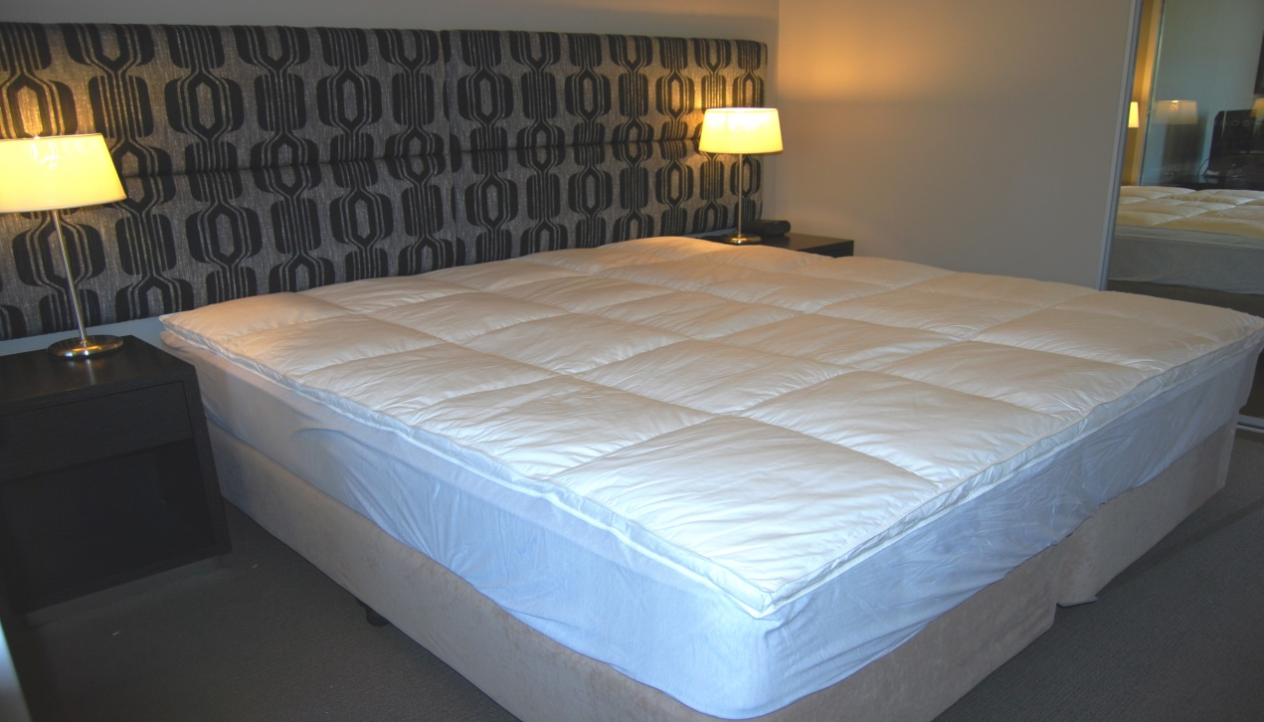
Mattress Toppers (Currently out of stock)
Is your mattress too hard, or do you need to just add some comfort to your bed? Our micro-loft fill mattress toppers could provide an added layer of comfort and luxury to your night's sleep.
Made from a 1100gms micro-loft fill, with a soft to the touch microfibre fabric cover, 3cm gusset side, along with a knitted fabric fitted skirt —45cm.
Specifications
Fill Weight 1100gms micro-loft
Fabric Cover Microfibre
Sizes Queen 156 x 206cm & King 187 x 206cm
Skirt 45cm knitted fabric fitted
Wall Size 3cm Gusset
Colour White

Slide 11
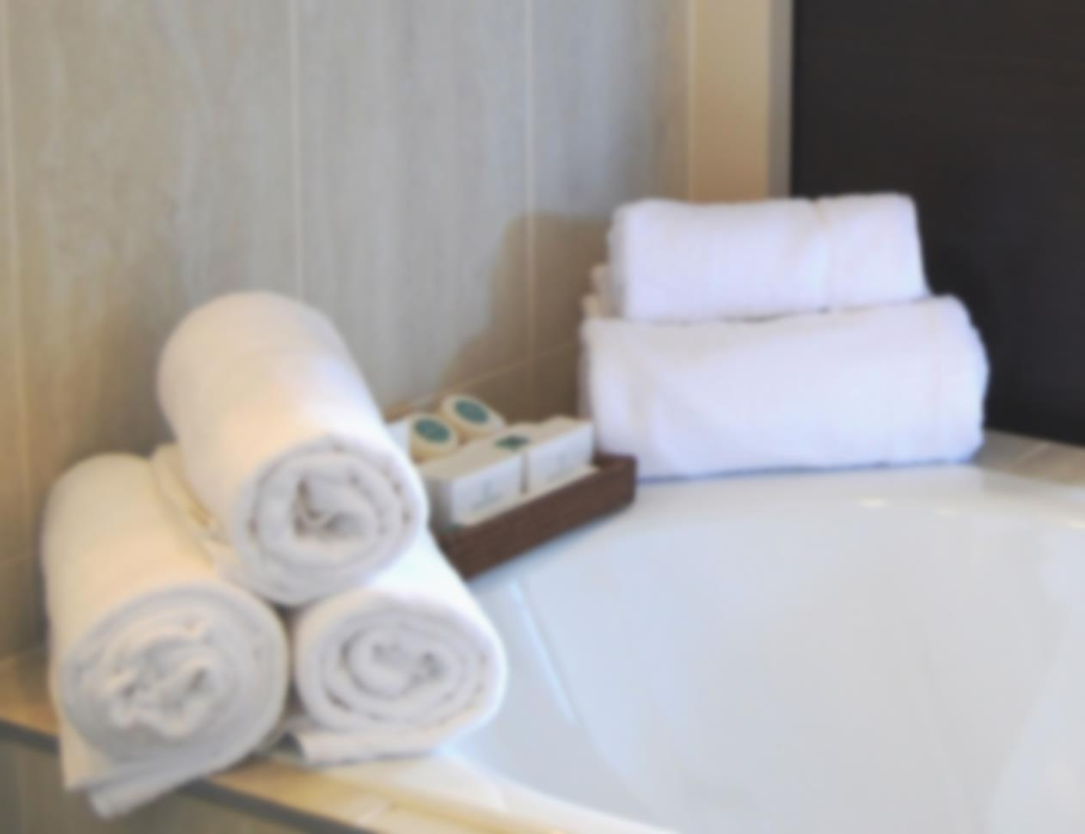
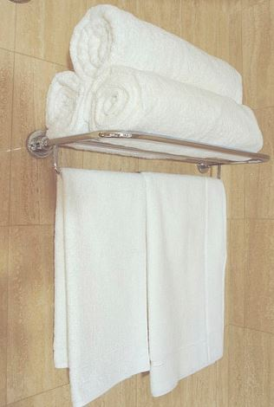
White Bath Linen Collection
Pearl Carded Towel Collection No Header 500gsm
Our Pearl Executive brand bath towels are of commercial grade, Soft to the touch, highly absorbent with quick-drying properties, making this a perfect bath towel for everyday
. Available in:
Face washer 33x35cm
Hand Towel 41x66cm
Bath Mat 51x71cm (framed inner drop pile border)
Bath Towel 70x140cm
Pearl Indulgence Collection No Header 600gsm
Our Pearl Indulgence brand White Bath Sheets are of commercial grade, made from 100% combed terry cotton towelling, Soft to the touch, high absorbency and quick drying properties make this bath sheet perfect for everyday use.
Available in:
Face washer 33x36cm
Hand Towel 40x80cm
Bath Mat 56x86cm (border)
Bath Towel 75x155cm
Bath Sheet 90x180cm

Slide 12
Navy
Chocolate
Charcoal Grey
Mushroom
Coloured Vat Dye Bath Linen Collection
Coloured Vat Dye Pearl Bath Towels
Our Pearl Indulgence Bath Sheets are of commercial grade, made from 100% combed terry cotton towelling. Soft to the touch, high absorbency and quick-drying properties make this bath sheet perfect for everyday use.
Navy, Chocolate, Charcoal Grey & Mushroom
Available in:
Face washer 33x35cm
Hand Towel 41x66cm
Bath Mat 51x71cm (framed inner drop pile border)
Bath Towel 70x140cm
Royal Blue Bath Towel Collection – No Header
Available in:
Hand Towel 41x66cm – 130grams per piece
Bath Towel 68x137cm – 435grams per piece

Slide 13
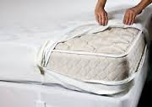
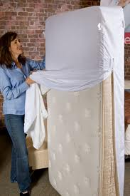
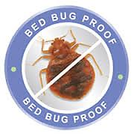
Buglock: Bed Bug Mattress or Base Protector-Non Waterproof
Features:
Completely encases mattress or bed base with 3 side bed bug proof zipper close.
Entomology Laboratory Certified and tested as bed bug entry and escape proof protection.
Protects from bed bugs entering or escaping.
Can be fitted on mattress or bed base
Fit mattress or base depth approx. 18-32cm
Made from a stretch poly fabric Non-waterproof with zipper close & patented ‘Buglock’ and ‘Secure Seal’ technology.
Machine washable hot, tumble-Machine washable hot, tumble-dry medium
Available in sizes: Single, King single, Double, Queen, King
Allerzip Smooth: Waterproof Dust Mite Bed Bug Mattress Protector
Features
Complete protection from dust mites bed bugs spills and stains
Waterproof for top bottom and sides of mattress
Expands to fit mattress depths from 20-40 cm
Can be used with electric blanket
Breathable smooth polyester sleep surface
Machine washable & tumble dry safe.
Waterproof yet breathable Miracle Membrane backing prevents accidental spills, perspiration stains and bodily fluids damaging your mattress.
Three sided zipper lock system for complete protection
The only Australian sold protector to be certified by an Entomology Laboratory to be bed dust mite proof & allergen proof.
Available in sizes: Single, King single, Double, Queen, King
Notes:
xxxxxxxxxxxxxxxxxxxxx

Slide 14
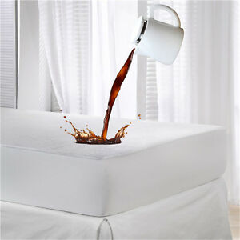
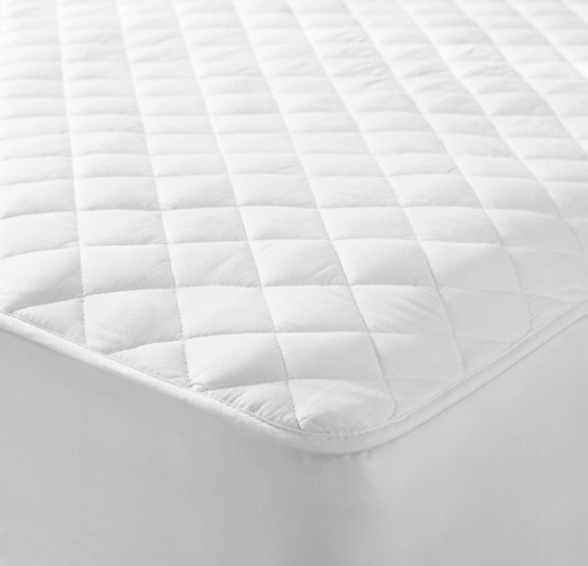
Waterproof Quilted Fitted Mattress Protector
Do you need more protection for your mattresses? Our waterproof quilted mattress protectors are absorbent and durable, designed with a luxurious microfibre fabric as the top cover with PU backing – not noisy like PVC backings can be, with 200gsm polyester fill, diamond stitch quilted with a microfibre fitted skirt.
Life can be easy using microfibre fabric as the cover, the fabric will not go out of shape like 100% cotton fabrics can, no more hourglass protectors on your beds!
Most stains could be easily removed from the microfibre fabric, leaving you with a clean, possible stain free protector for your beds.
Specifications
Material 100% microfibre fabric cover with PU waterproof backing
Fill Weight 200gsm polyester
Skirt 36cm Microfibre fabric fitted
Single 90 x 190 x 36cm
King Single 104 x 203 x 36cm
Long Single 94 x 203 x 36cm
Double 137 x 190 x 36cm
Queen 152 x 203 x 36cm
King 182 x 203 x 36cm

